Slide 1
Private Funding Opportunity
Offered by:
Positive Vibe Property Partners, LLC

Slide 2
Who is Positive Vibe Property Partners?
Positive Vibe Property Partners, LLC is a real estate investment company owned and managed by Mara and Carlos Santos
Founded in 2020
We are experienced in finding distressed properties, purchasing them at a discount, renovating them, and reselling them at market value or keeping them as rental properties
Our team consist of real estate agents and brokers, contractors, attorneys, accountants, marketing professionals, and investors
We operate in the Atlanta and suburbs markets.

Slide 3
What We Do
Market for and identify real estate investment opportunities
Offer private investors opportunities to make a significant return on investment in a short amount of time
Purchase real estate at a heavily discounted price with funds from private investors
Wholesale discounted real estate to other real estate investors
Rehabilitate distressed properties to return the property above market value
Sell rehabilitated property for a profit
Hold properties for long term rental properties

Slide 4
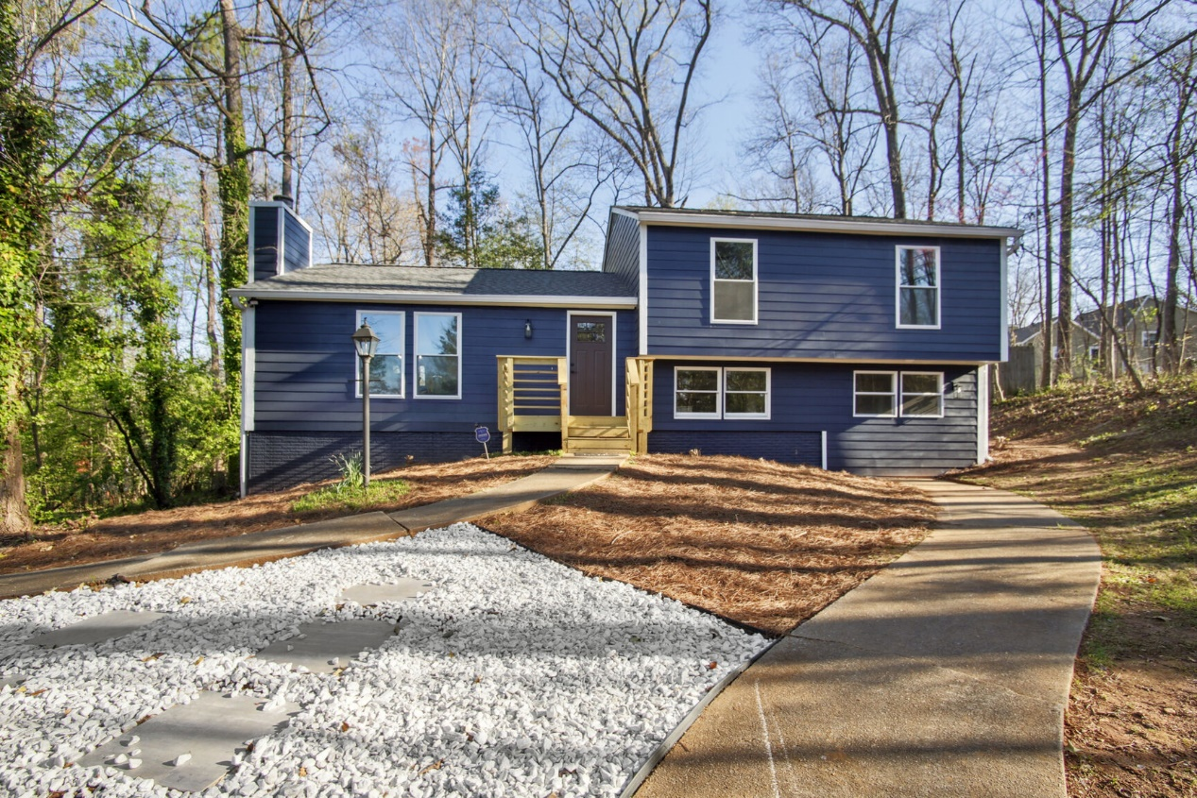
Completed Project
4 bedrooms
3 bath
Split level, 2398 sq.ft.
HOA Community in Stone Mountain, GA
Flip and sold
851 Bridgewater Ct Stone Mountain, GA

Slide 5
Complete Project Information
Home purchase amount = $180,000
Cost of Repairs = $75,000
Realtor, Holding (lender fees) and Closing Costs = $40,000
After repair value= $340,000
Profit = $45,000

Slide 6
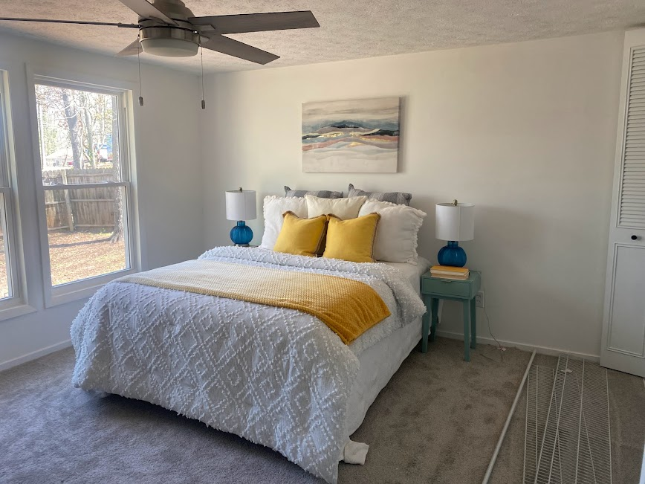
Before and after Master Bedroom

Slide 7
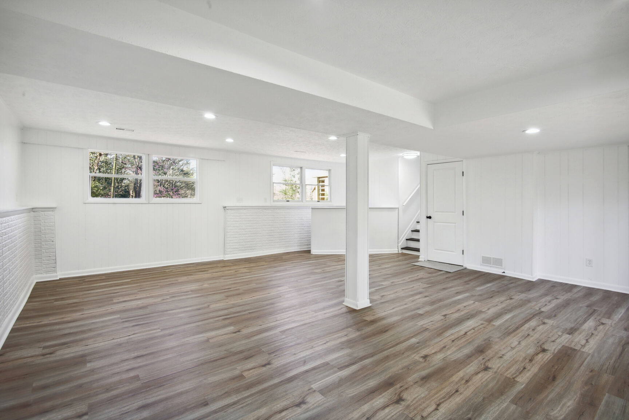
Before and after Basement

Slide 8
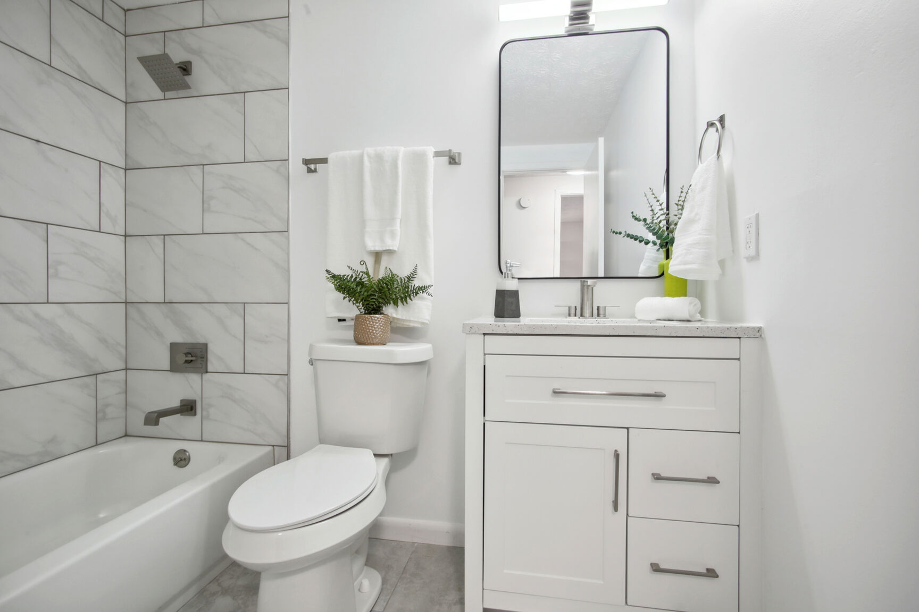
Before and after Guest Bath

Slide 9
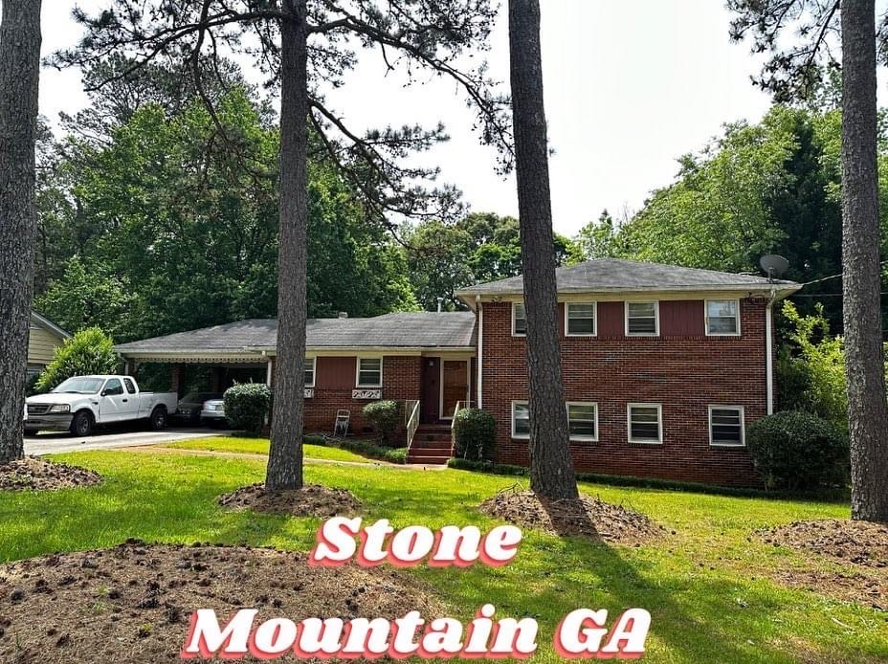
Current Project
4 bedrooms
2.5 bath
Split level brick house – 1956 sq.ft.
Established neighborhood
Good Flip with great potential
Blackhawk Dr
Stone Mountain, GA

Slide 10
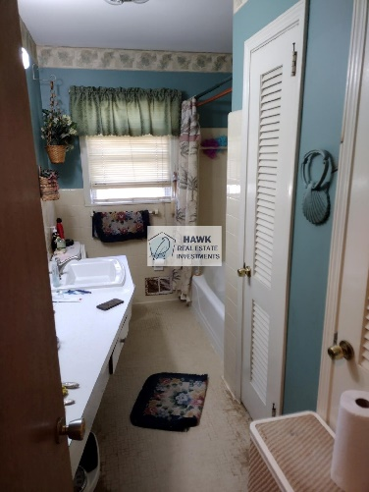
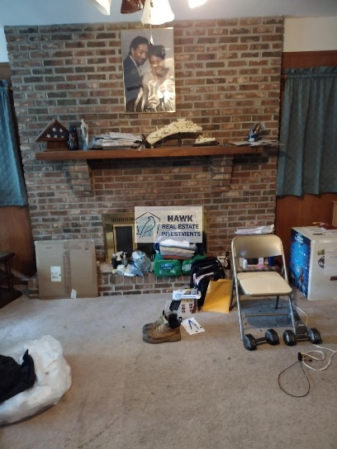
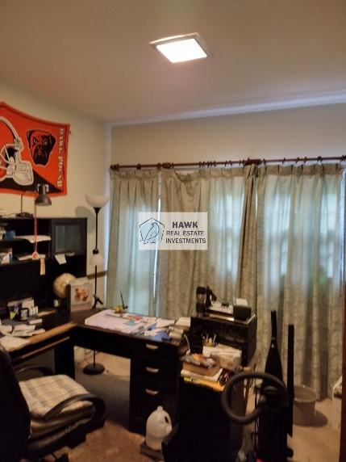
Pictures

Slide 11
Current Project
Home purchase amount = $200,000
Estimated Cost of Repairs = $55,000
After repair value= $339,000

Slide 12
Renovation plans
Bring down the kitchen wall to open up the kitchen to the living room area
Renovate the existing three bathrooms
New flooring throughout, carpet in bedrooms and hardwood in common areas
Paint interior
Install new HVAC
New front door
Exterior: Pressure wash brick, paint siding

Slide 13
Resale Comps

Slide 14
Your Opportunity
Provide private funding for this project at $250,000 for up to 6 months
Deal will be processed through closing attorney with all protection that the bank has:
Secured with a promissory note
Security Deed (1st position)
Lender will be included as loss payee on the home insurance policy
15% Annual Interest paid a the end of the project or 25% of the profit, whichever is higher
If the project extends past 6 months, rates will be renegotiated
Original loan amount plus profits will be paid back at closing of the final sale

