Slide 1
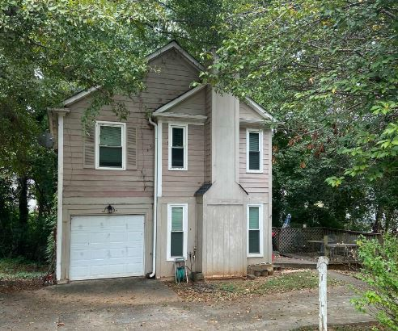
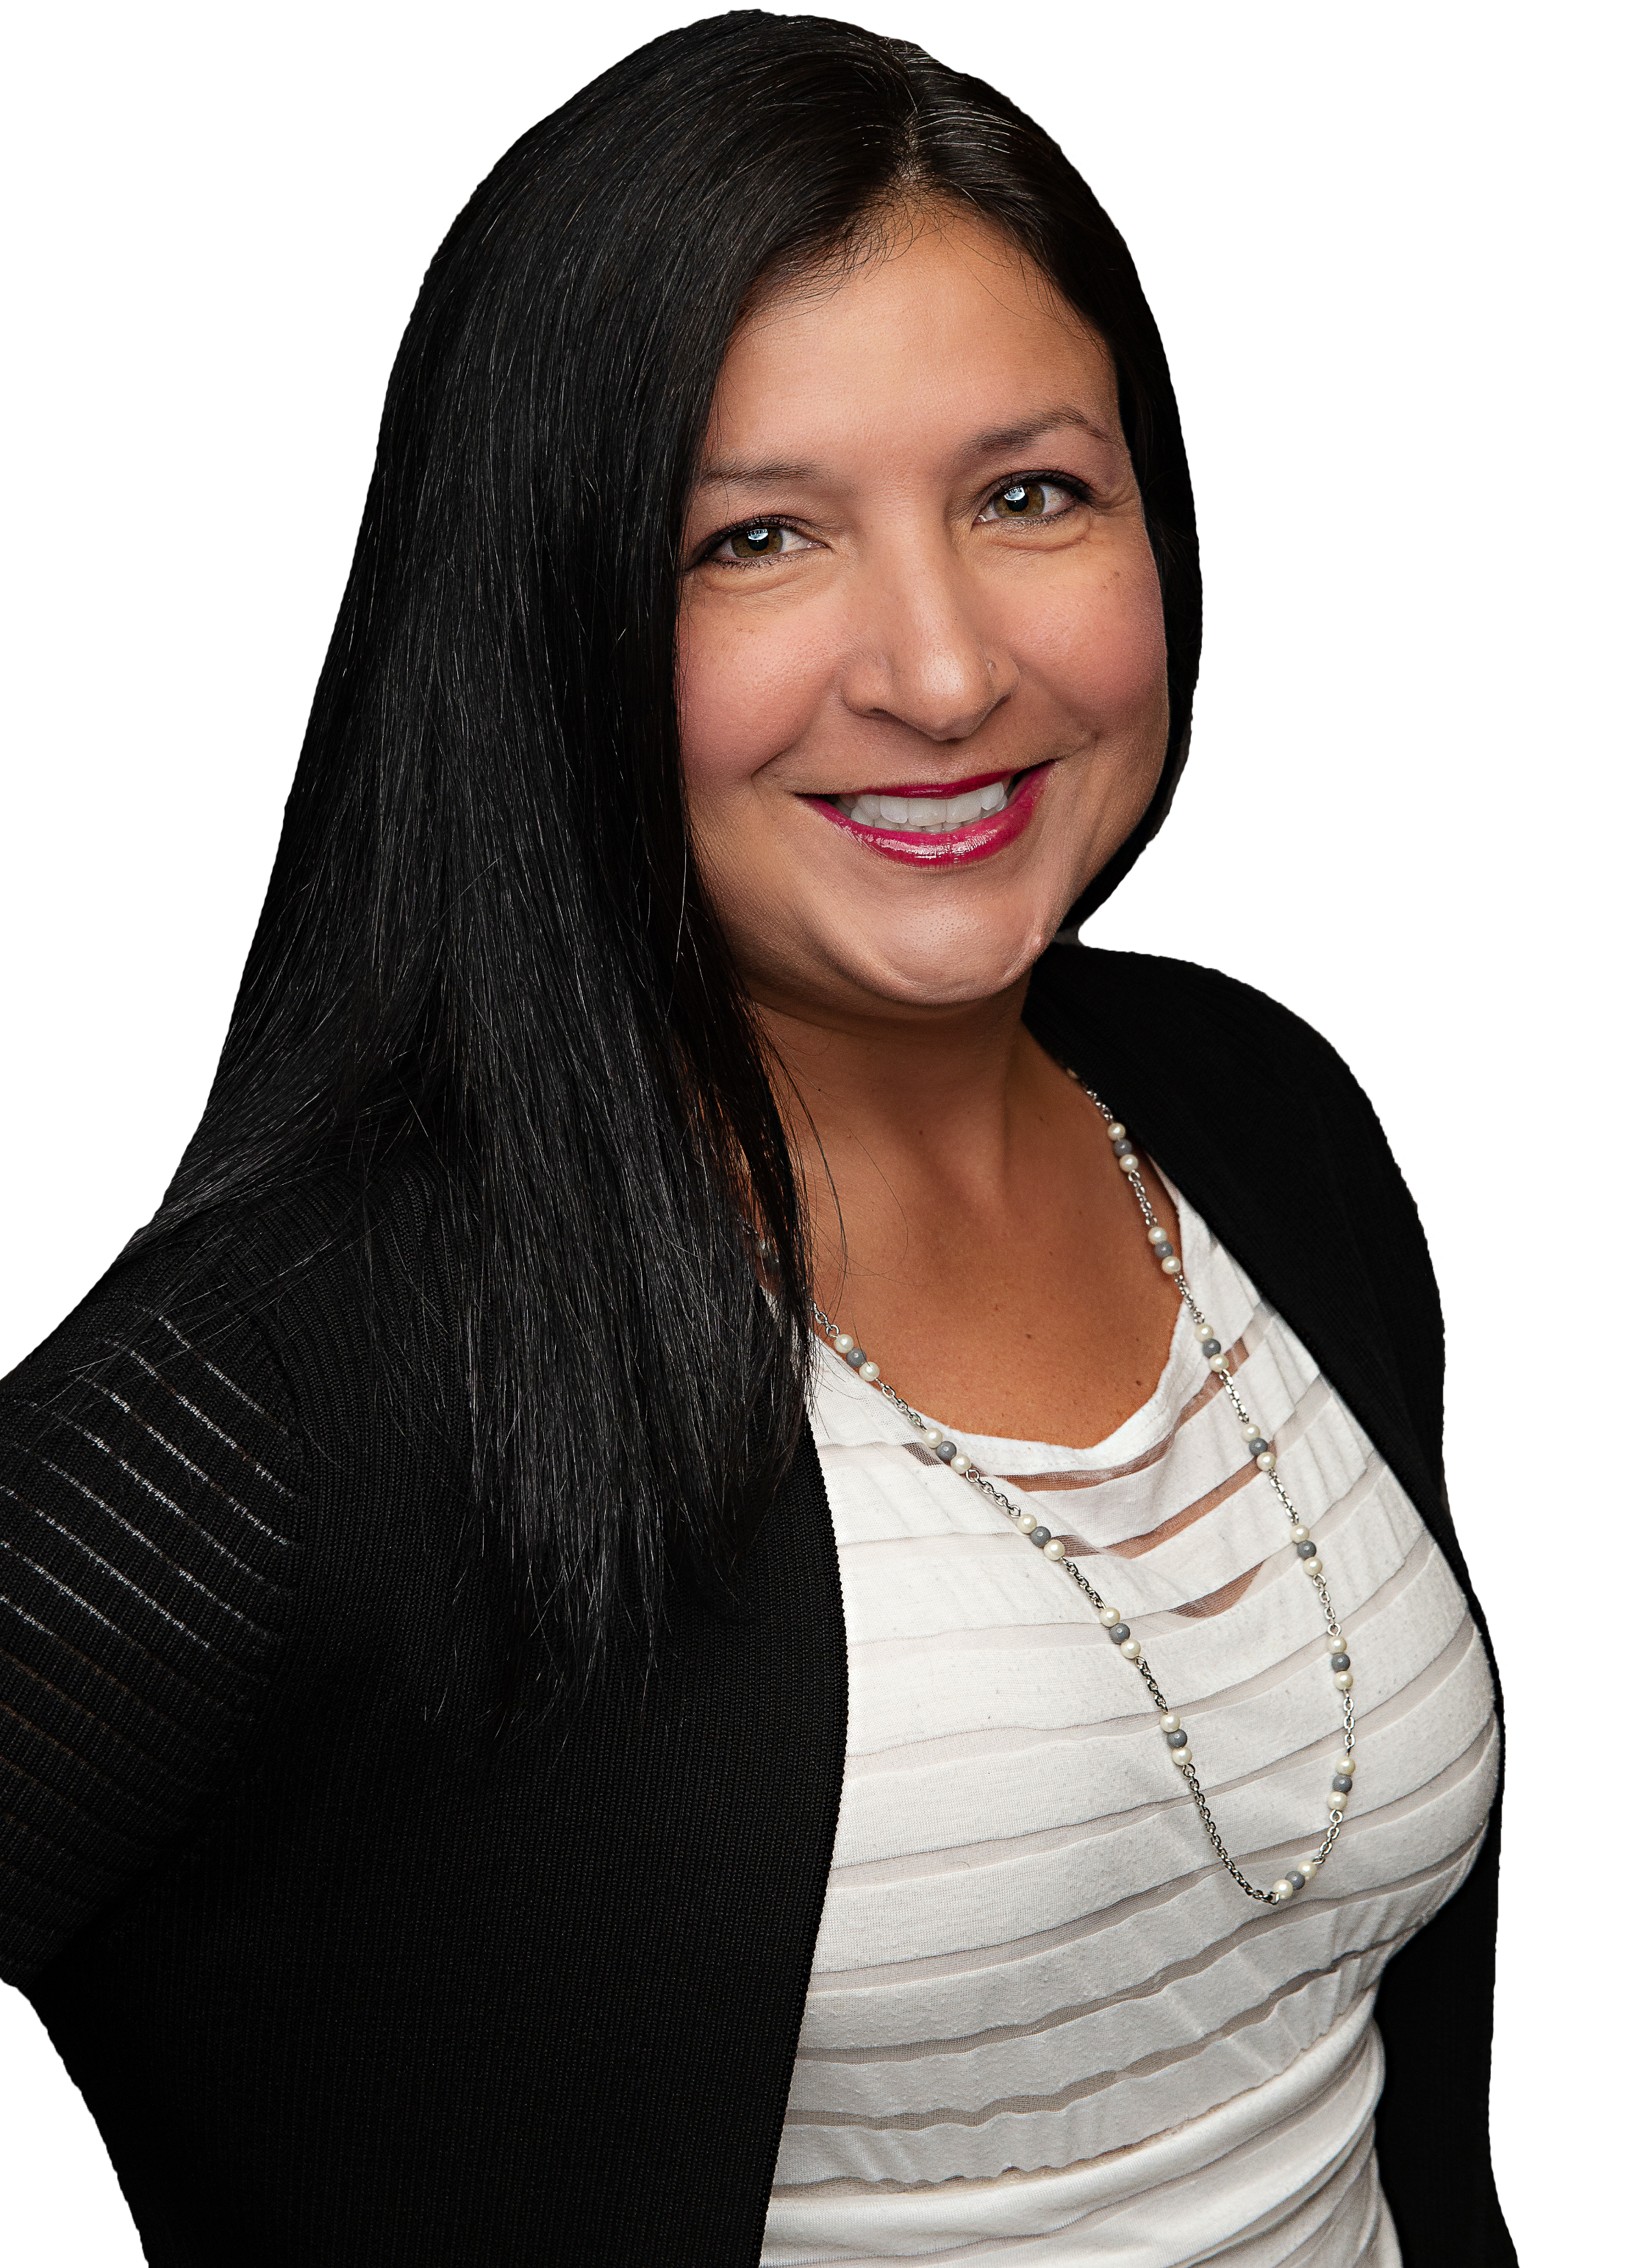
THE
PERFECT LOAN PROPOSAL
By Mara Santos

Slide 2
Section 1: About Our Operations
1
OUR BACKGROUND
My husband and I entered the real estate industry in 2013, initially focusing on rental properties. In 2020, leveraging our management expertise, we established Positive Vibe Property Partners with the primary goal of engaging in property flips. During this period, we juggled flipping projects alongside our regular jobs. Starting gradually, we encountered challenges, learned from mistakes, and gained valuable experience. In 2022, I obtained my realtor license and transitioned to real estate as a full-time pursuit, leaving my previous job. Additionally, we extend loans, leveraging our understanding of what constitutes a sound deal for lending purposes
2
STRATEGIC OBJECTIVE
Our project acquisitions primarily come from distressed houses from the MLS and wholesalers. Our niche is in lower to mid-priced single-family residences northeast of Atlanta, which we consider our bread and butter.. We've established systems that allow us to complete projects swiftly, coupled with a strategy of competitive pricing. Successfully, our turnaround time from acquisition to sale has consistently been less than four months. Additionally, I personally acquire houses based on my preferences, considering them as potential long-term holdings. In the event of unforeseen circumstances, we have the option to refinance and retain the property as a rental.
3
OUR VISION
Our primary emphasis is on delivering an excellent product at an affordable price for homeowners seeking a beautiful, hassle-free house without breaking the bank. We have achieved success in this endeavor, with our homes consistently selling rapidly and often receiving multiple offers.

Slide 3
Section 1: About Our Operations
5
OUR COMPANY
IN NUMBERS
We’ve been doing flips for 4 years. We have used Hard Money, Private Money and our own capital to fund the deals.
4
We have done AirBnBs, long term rentals and flips. Currently own 3 rentals, have one new construction in the market and one flip project running.
13

Slide 4
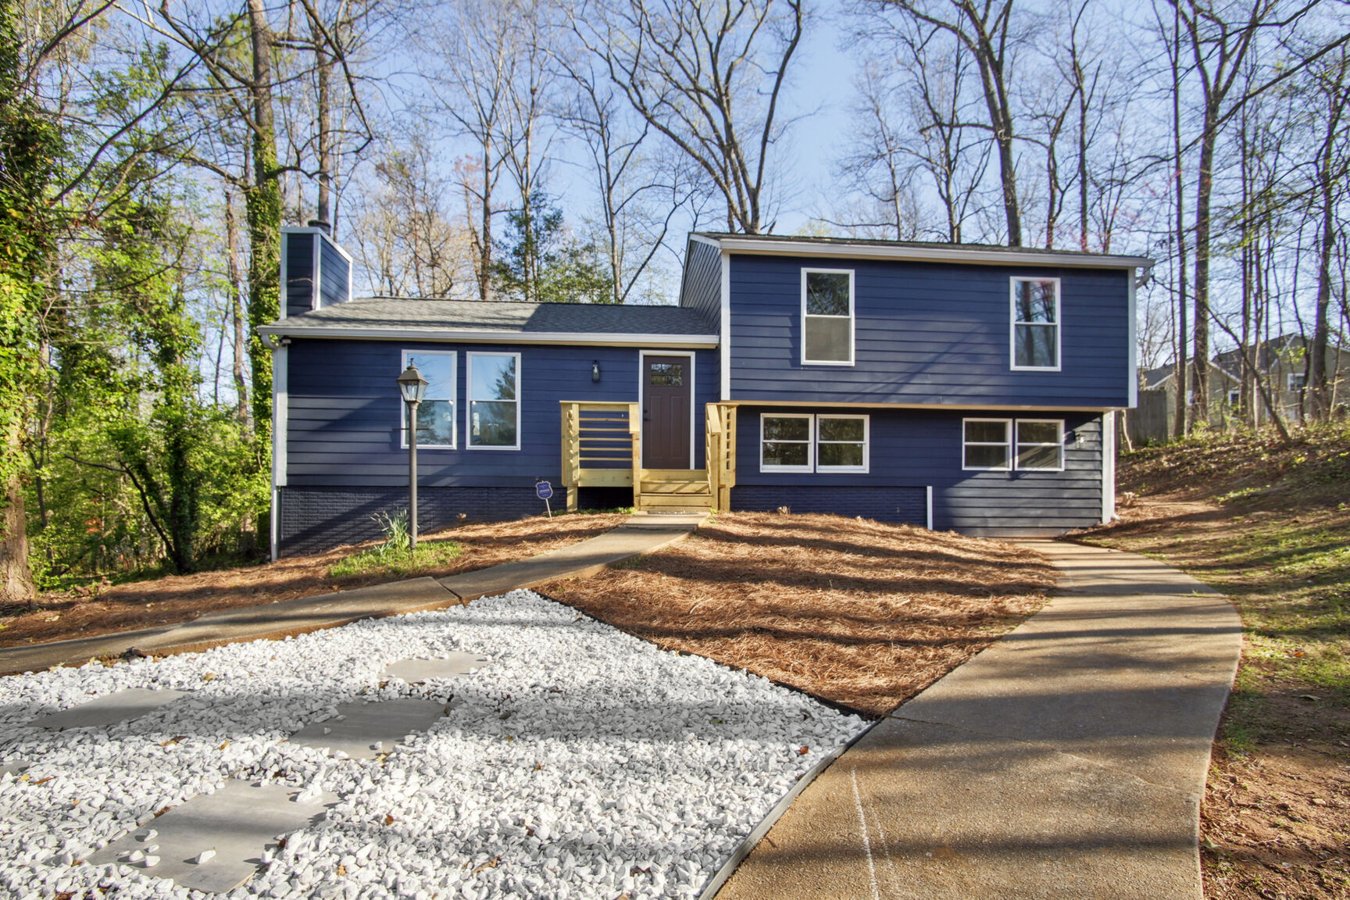
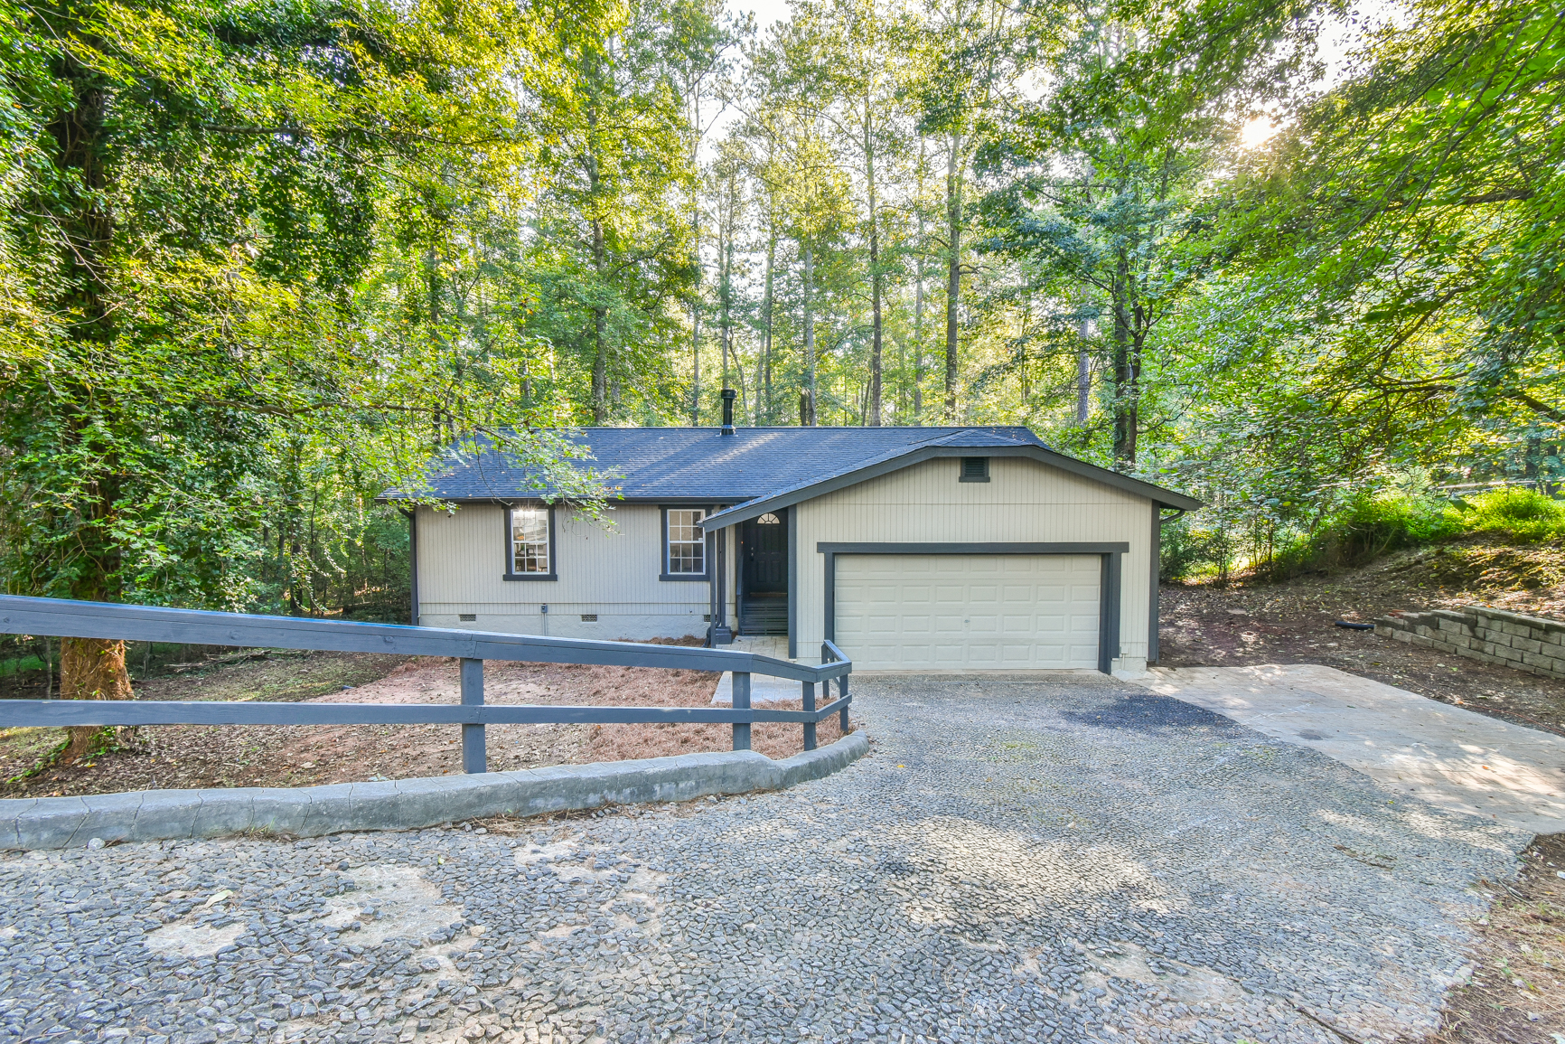
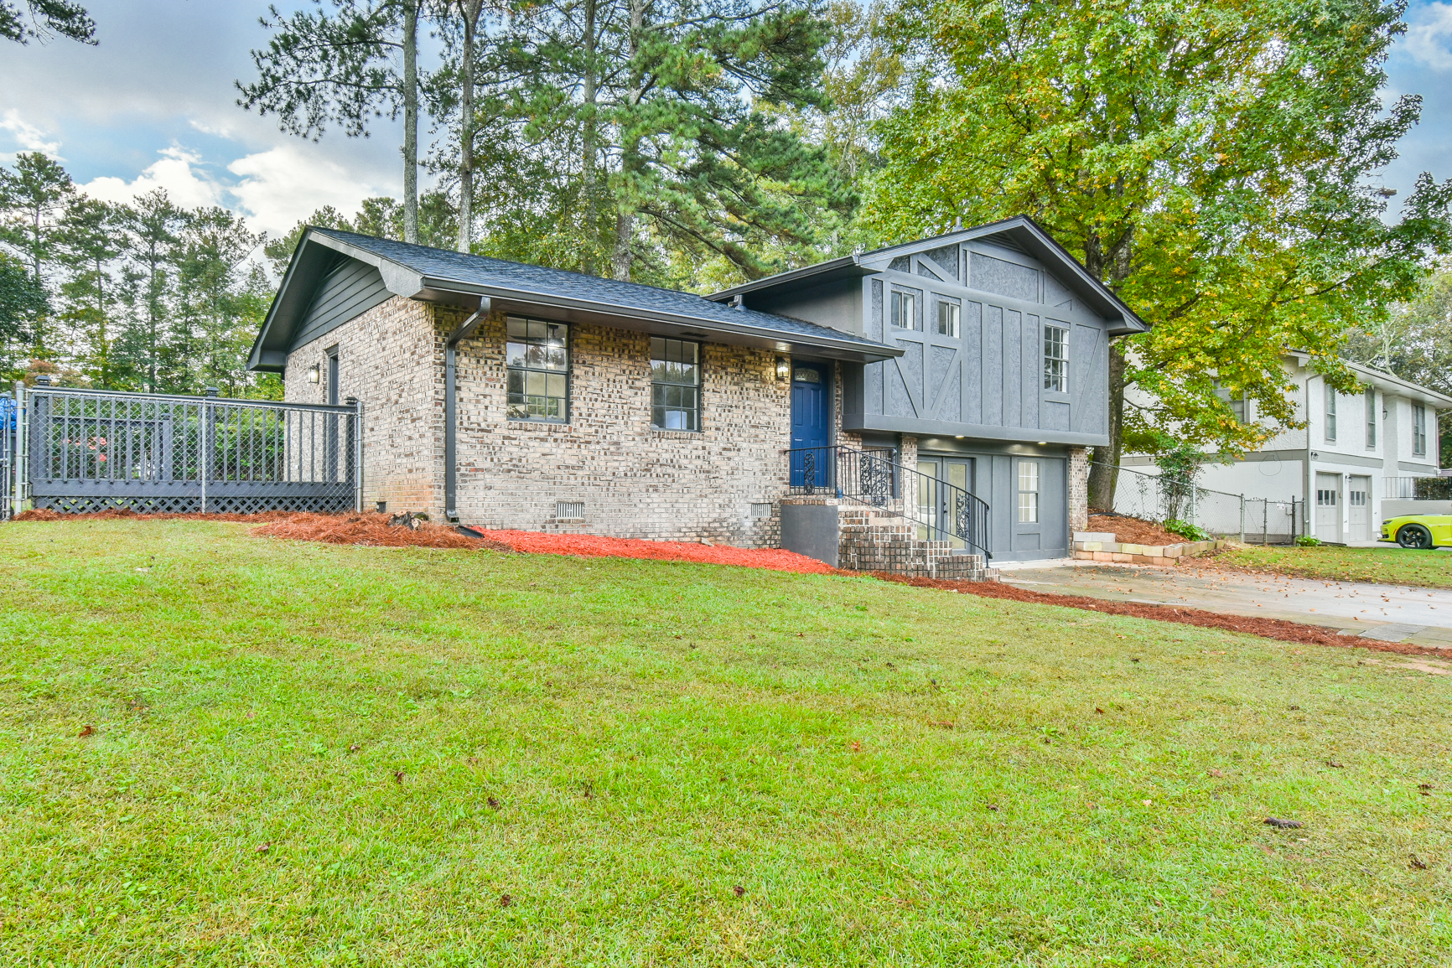
Section 2: Our Track Record
6
Our 2023 Record
2023 FLIP #1
851 Bridgewater Ct
Stone Mountain, GA
Time from Buying to Selling: 3 months
Purchase Price: $180,000
Repairs: $74,000
Sale Price: $340,000
Net Profit: $45,700
2023 FLIP #2
4288 Bradley Dr
Snellville, GA
Time from Buying to Selling: 2 months
Purchase Price: $170,000
Repairs: $40,848
Sale Price: $265,000
Net Profit: $23,500
2023 FLIP #3
4338 Venus Dr
Norcross, GA
Time to Buying to Selling: 2 months
Purchase Price: $205,000
Repairs: $72,670
Sale Price: $334,000
Net Profit: $43,812

Slide 5
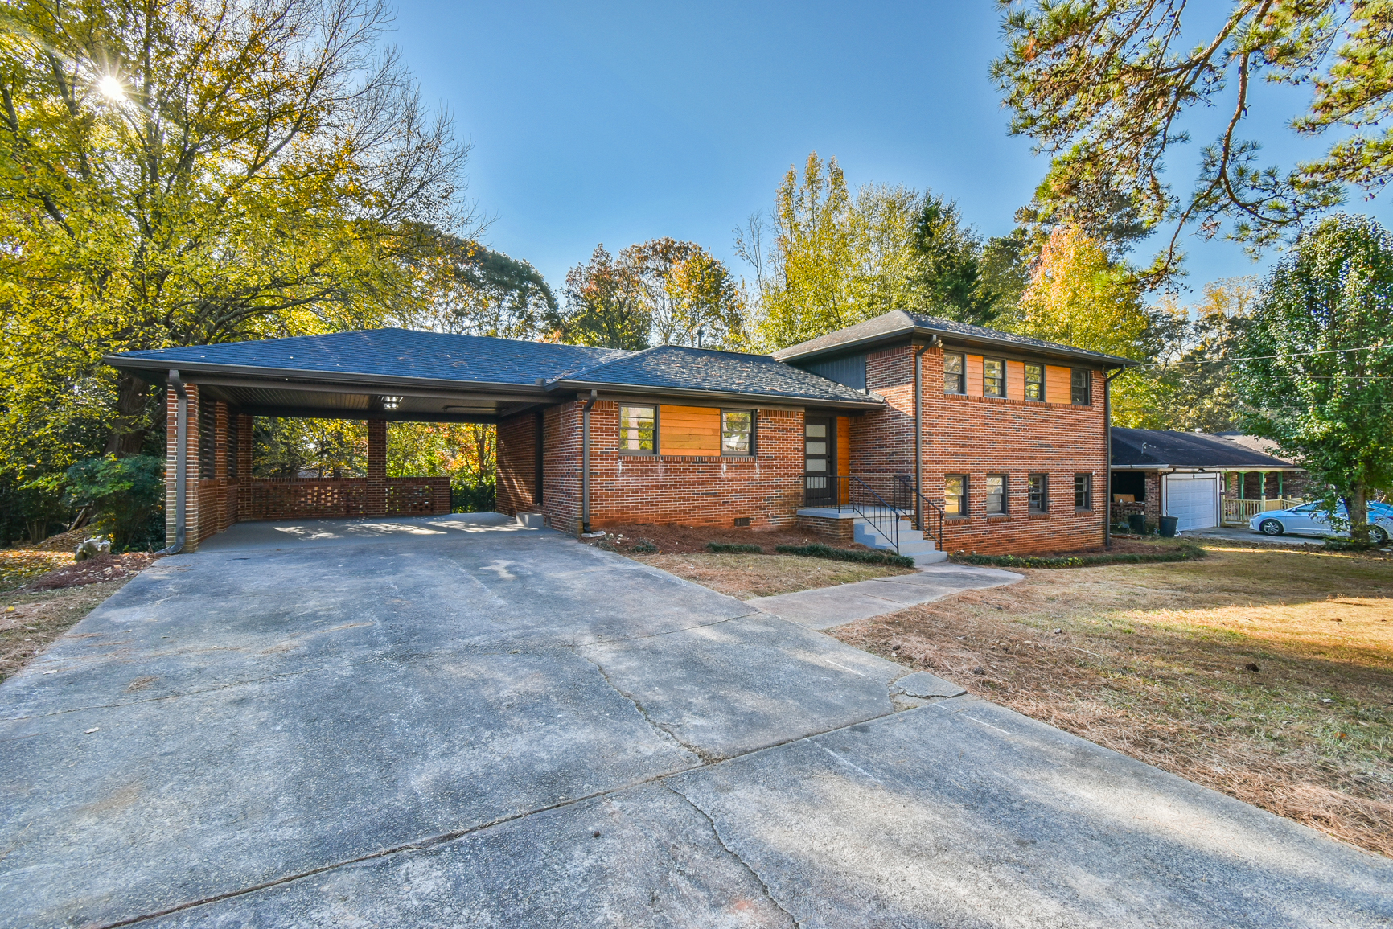
Section 2: Our Track Record
Continued
2023 FLIP #4
4135 Blackhawk Dr
Stone Mountain
Time from Buying to Selling: 3.5 months
Purchase Price: $200,000
Repairs: $68,234
Sale Price: $364,000
Net Profit: $41,000

Slide 6
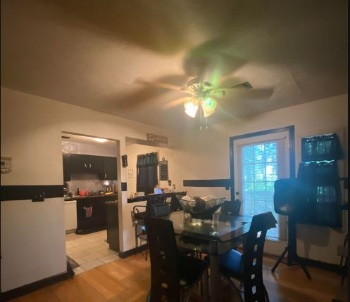
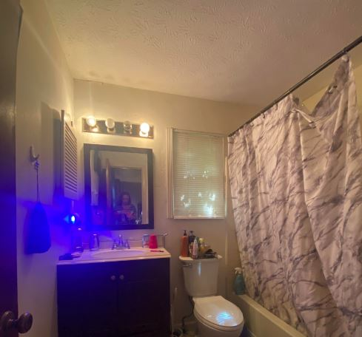
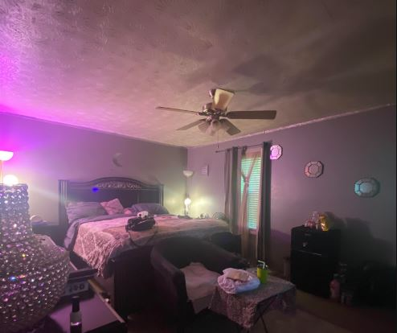
Section 3: The Deal At Hand
Project proposal
7
This is a SFH , 2 stories with a finished basement in a cul-de-sac. Four bedrooms, 2.5 bathrooms and 2162 sqft. Mainly cosmetic project; updating bathrooms, kitchen, new flooring and painting. HVAC, water heater and windows are newer. The main bulk of the job is in the exterior, it needs a new roof, siding needs a lot of work and new decks and fence to get a nice curb appeal.

Slide 7
Section 3: The Deal At Hand
Numbers
Purchase Price: $195,000
Repairs: $60,000
After Repair Value: $320,000
Estimated time to sell: 4-6 months
Resale Comparables from MLS

Slide 8
Section 3: The Deal At Hand
Your Opportunity
Provide Private Funding for this project for first, second and/or third position. Minimum $50,000 investment, I will fund the rest of the money
Deal will be escrowed at Wasdin Law Closing Group, LLC closing 03/22/24 with all protection that a regular bank will have:
*Secured with promissory note
*Security Deed
*Secured as loss payee on the home insurance policy
15% annual interest paid at the end of the project
Original loan amount plus profits will be paid at closing of the final sale

